Slide 1

Recognition of Handwritten Math Symbols Using Deep Learning
Capstone Three Project, June 2020 Cohort
Prashant gupta
Mentor: Mr. Arindam Mondal

Slide 2
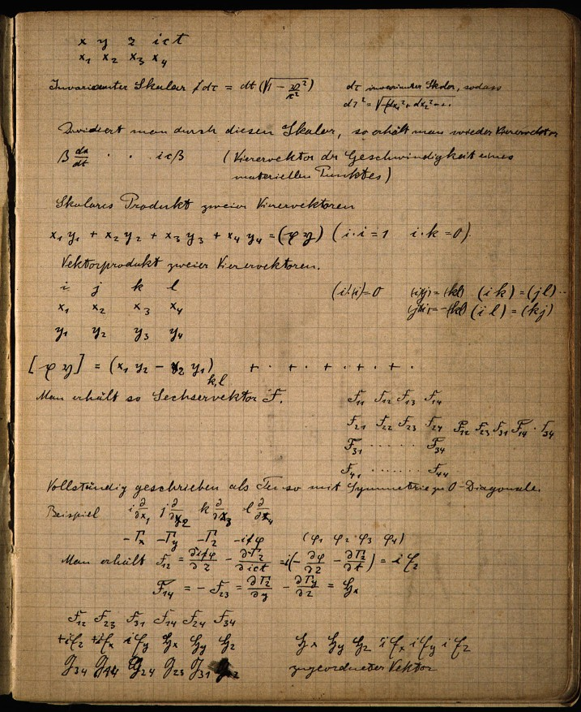
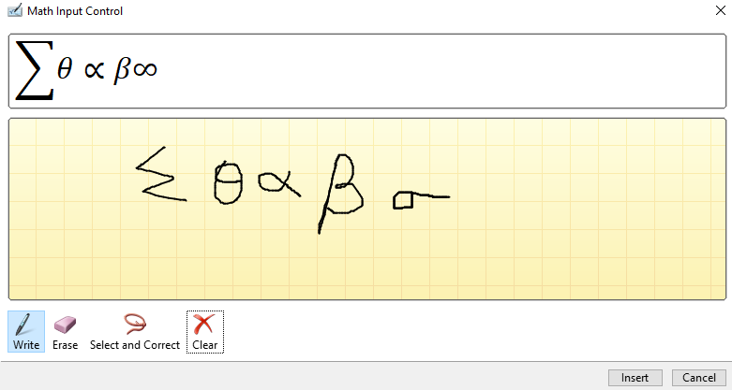
Motivation for the study – The Problem
Source: - https://www.pitt.edu/~jdnorton/Goodies/Zurich_Notebook/
Notes:
This is the page from notebook of Einstein where he did the calculations while developing General Theory of Relativity.
Now Imagine converting all these equations to digital format to preserve it to lifetime. We have to rewrite each equation in corresponding software
Various researchers have worked on identifying the mathematical symbols. On write hand side you can see the tool of Microsoft word where you can write the equation with your digital pen and it automatically converts to digital form. This the amin motivation of this study “TO CONVERT HANDWRITTEN EQUATIONS TO DIGITAL FORM”

Slide 3

WHO Might Care?
Academicians
Research Scholars
Journal Publishers
Book Publishers
Students
Professors
Research Laboratories
Research Institutes
Source: - https://economictimes.indiatimes.com/industry/services/education/indian-universities-try-to-woo-foreign-academicians-whats-pushing-them-away/articleshow/66492015.cms?from=mdr

Slide 4
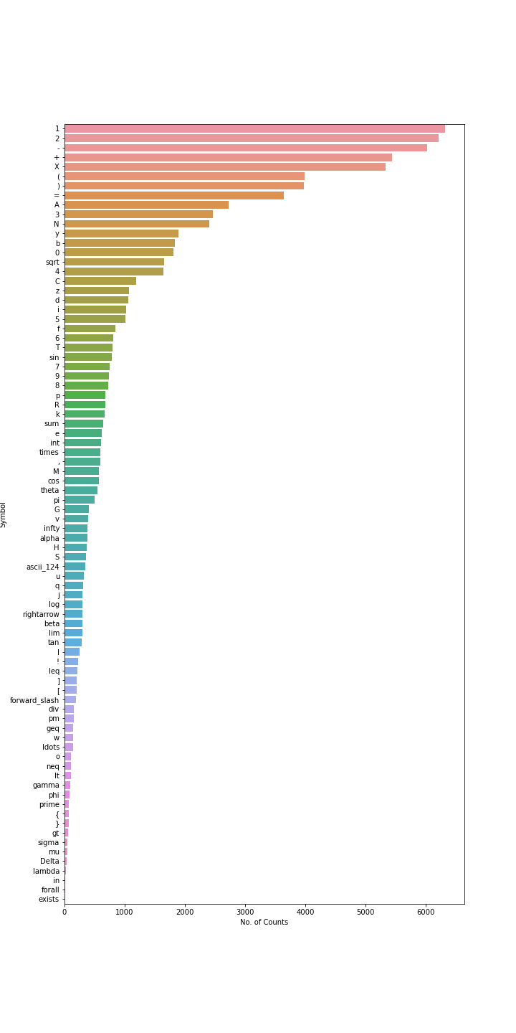
Data Information
The dataset for scanned images of mathematical symbols have been acquired from Kaggle
The dataset available on Kaggle [5] contains 375,974 images of handwritten math symbols classified into 82 labels like +, -, cos, Δ, →, etc.
Each image is a 45x45 pixel grayscale image and hence not much pre-processing is required for this dataset.

Slide 5
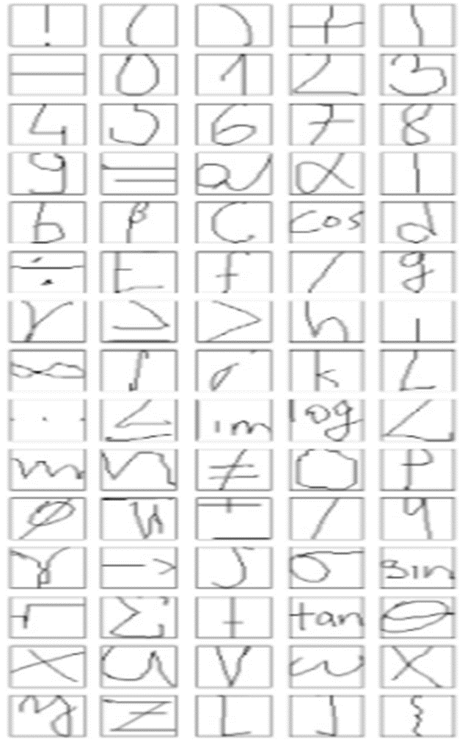
Data Information

Slide 6
PROCESS MAP for predicting activity
Input Data
Data Cleaning
Data Wrangling
Pre-processing
Deep Learning Architectures
Metrics Evaluation
Recommended Algorithm
Scanned images of different symbols
Removing duplicate images
Selecting specific no. of images to reduce computational time
Dividing into groups of similar type (to reduce the computational time)
Train-Test Split
Standardization of image arrays
Identifying architectures for experiments (LeNet & Modified Lenet)
Hyper parameter tuning (LR and Optimizer)
Calculation of Accuracies for each group
Chosing best architecture and hyperparameters based on model metrics evaluation

Slide 7
Data Wrangling
The classes have been grouped based on similarity because training on all 82 classes will take long time.
Group Name | Symbols
Group-1 | -, ,, !, (, ), [, ], {, }, +, =
Group-2 | 0 to 9
Group-3 | A to M
Group-4 | N to Z
Group-5 | Alpha, beta, gamma, phi, pi, sigma, theta
Group-6 | Ascii24, division, forward-slash, greater than equals, greater than, integral, idots, less than equals, less than, not equals, right arrow, square root, summation, multiplication, pluss minus
Group-7 | Cos, infinity, limit, log, prime, sin, tan

Slide 8
Pre-Processing
The basic approach used to create training and test dataset is as follows:
If a particular folder contains more than 200 images then first 100 images will be used as training data and next 100 will be used as test data.
If the folder contains less than 200 images but greater than 50 images then it will be split in the ratio of 80% for training and 20% for test.
If the folder consists of less than 50 images then it will not be considered for classification.

Slide 9
Deep Learning Architectures
CNN architectures have been used for classifying images of each group.
The architecture of Lenet was first applied on similar kind of images like ours.
Therefore, we have used architecture of Lenet but instead of using tanh as activation function relu is used since relu gives better accuracy.
The Lenet architecture have been modified by modifying the parameters like stride, padding and number of nodes in a layer.
Apart from modified Lenet architecture as reported in Lu and Mohan has also been used for our experiments.

Slide 10
Deep Learning Architectures
Architecture-1 Model-1
Input Layer
Conv1 (layers=16, kenrel=3, stride=1, padding=same)
MaxPool2d
Hidden Layer1 (nodes=120)
Flatten
Output Layer (softmax)
Input Layer
Conv1 (layers=16, kenrel=3, stride=1, padding=valid)
MaxPool2d
Hidden Layer1 (nodes=120)
Flatten
Output Layer (softmax)
Architecture-1 Model-2
Input Layer
Conv1 (layers=16, kenrel=3, stride=2, padding=valid)
MaxPool2d
Hidden Layer1 (nodes=120)
Flatten
Output Layer (softmax)
Architecture-1 Model-3
Input Layer
Conv1 (layers=16, kenrel=5, stride=1, padding=valid)
MaxPool2d
Hidden Layer1 (nodes=120)
Flatten
Output Layer (softmax)
Architecture-1 Model-4
Input Layer
Conv1 (layers=32, kenrel=5, stride=1, padding=valid)
MaxPool2d
Hidden Layer1 (nodes=120)
Flatten
Output Layer (softmax)
Architecture-1 Model-5

Slide 11
Deep Learning Architectures
Architecture-1 Model-6
Input Layer
Conv1 (layers=64, kenrel=5, stride=1, padding=valid)
MaxPool2d
Hidden Layer1 (nodes=240)
Flatten
Output Layer (softmax)
Architecture-2 Model-1
Input Layer
Conv1 (layers=6, kenrel=5, stride=1, padding=valid)
MaxPool2d
Hidden Layer1 (nodes=120)
Flatten
Output Layer (softmax)
MaxPool2d
Conv1 (layers=16, kenrel=5, stride=1, padding=valid)
Hidden Layer2 (nodes=84)
Architecture-2 Model-2
Input Layer
Conv1 (layers=16, kenrel=3, stride=1, padding=valid)
MaxPool2d
Hidden Layer1 (nodes=240)
Flatten
Output Layer (softmax)
MaxPool2d
Conv1 (layers=32, kenrel=3, stride=1, padding=valid)
Hidden Layer2 (nodes=168)
Architecture-3 Model-1
Input Layer
Conv1 (layers=6, kenrel=5, stride=1, padding=valid)
MaxPool2d
Hidden Layer1 (nodes=120)
Flatten
Output Layer (softmax)
MaxPool2d
Conv1 (layers=16, kenrel=5, stride=1, padding=valid)
Hidden Layer2 (nodes=84)
MaxPool2d
Conv1 (layers=32, kenrel=5, stride=1, padding=valid)
Hidden Layer2 (nodes=58)
Architecture-3 Model-2
Input Layer
Conv1 (layers=16, kenrel=5, stride=2, padding=same)
MaxPool2d
Hidden Layer1 (nodes=240)
Flatten
Output Layer (softmax)
MaxPool2d
Conv1 (layers=32, kenrel=5, stride=2, padding=same)
Hidden Layer2 (nodes=168)
MaxPool2d
Conv1 (layers=64, kenrel=5, stride=2, padding=same)
Hidden Layer3 (nodes=116)
Architecture-3 Model-3
Input Layer
Conv1 (layers=6, kenrel=9, stride=1, padding=same)
MaxPool2d
Hidden Layer1 (nodes=576)
Flatten
Output Layer (softmax)
MaxPool2d
Conv1 (layers=16, kenrel=9, stride=1, padding=same)
Hidden Layer2 (nodes=288)
MaxPool2d
Conv1 (layers=16, kenrel=5, stride=1, padding=same)
Hidden Layer3 (nodes=144)

Slide 12
DEEP learning Algorithms
Hyperparameters
S. No. | Hyperparameter | Values considered for tuning
1. | Optimizer | Stochastic Gradient Descent (SGD) Adam optimizer
2. | Learning Rate | 0.01, 0.1

Slide 13
Accuracies of Best Model for Each Group
Notes:
Deep Architecture is more accurate as we can see that for each group Architecture-3 is having best accuracies

Slide 14
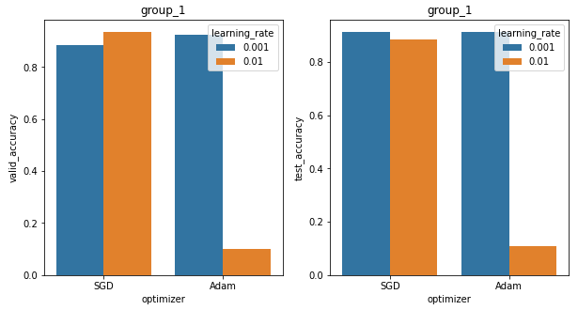
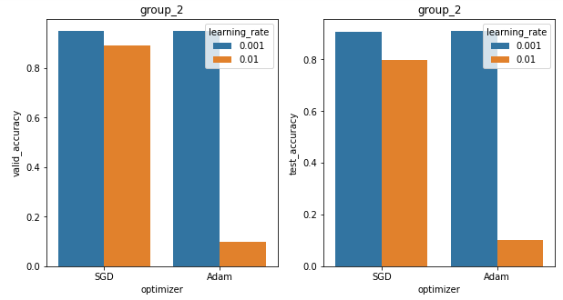
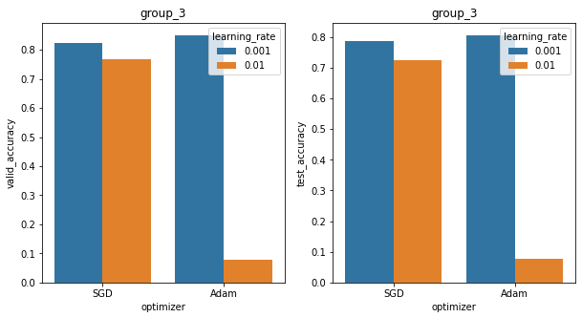
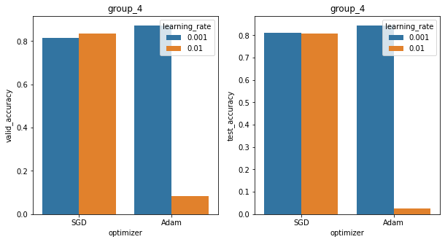
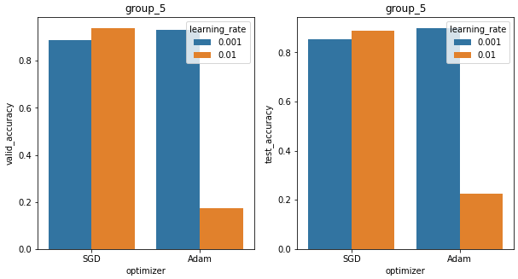
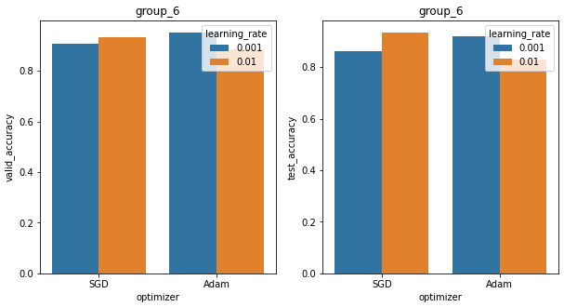
Effect of Hyperparameters on Accuracies
Notes:
Adam optimizer a learning rate of 0.01 is not good, however for SGD optimizer both the learning rates yield comparative accuracies.

Slide 15
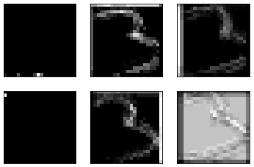
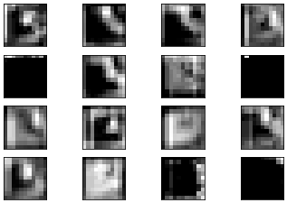
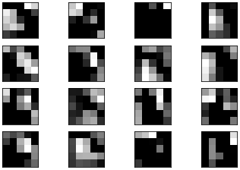
Visualization of Image after Applying CNN layers
Notes:
Image of 3 after convolution layers, The figures show that initial layers of CNN predicts the low level features and advanced layers indicate prediction of higher level features.

Slide 16
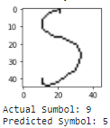
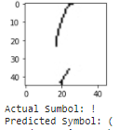
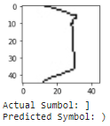
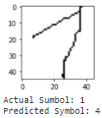
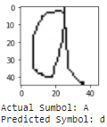
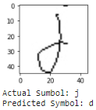
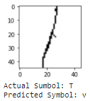
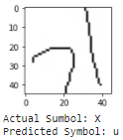
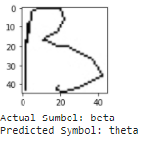
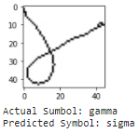
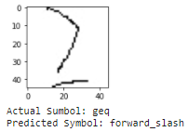
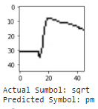
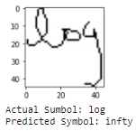
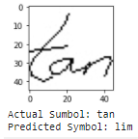
Examples of Misclassified Images
Notes:
Image of 3 after convolution layers

Slide 17
Scope of Future Work
Predict all 71 classes with a deep architecture
Use of Image Segmentation along with image recognition to predict equations
Use of transfer learning to reduce training time
Notes:
There are several directions for future work, the most important of which is to predict all 71 classes at once using a deep architecture which will take longer time to train. The second scope would be to club the image segmentation techniques with image recognition of each character which will be used for real life problems and converting handwritten mathematical equations to digital form. The third direction could be use of transfer learning algorithms of already specified CNN architectures to reduce the training time.

Slide 18
References
Nazemi Azadeh, Tavakolian Niloofar, Ftizpatrick Donal, Fernando Chandrika & Suen Ching Y. (2019). Offline Handwritten Mathematical Symbol Recognition Utilising Deep Learning. (https://arxiv.org/pdf/1910.07395.pdf)
Matsakis Nicholas E. (1999). Recognition of Handwritten Mathematical Expressions. Submitted to the Department of Electrical Engineering and Computer Science on May 21, 1999, in partial fulfillment of the requirements for the degrees of Bachelor of Science in Electrical Engineering and Computer Science and Master of Engineering in Electrical Engineering and Computer Science.
Jimenez Nicolas D & Nguyen Lan. Recognition of Handwritten Mathematical Symbols with PHOG Features.
(http://cs229.stanford.edu/proj2013/JimenezNguyen_MathFormulas_final_paper.pdf)
Lu Catherine and Mohan Karanveer, Recognition of Online Handwritten Mathematical Expressions Using Convolutional Neural Networks (http://cs231n.stanford.edu/reports/2015/pdfs/mohan_lu_cs231n-project-final.pdf)
Handwritten math symbols dataset (Kaggle)
(https://www.kaggle.com/xainano/handwrittenmathsymbols?select=data.rar)

Slide 19
THANK YOU

